Slide 1

Chapter 04
Local Area Network: LANs
Data Communications and Networking, With TCP/IP protocol suite Sixth Edition
Behrouz A. Forouzan
© 2022 McGraw Hill, LLC. All rights reserved. Authorized only for instructor use in the classroom.
No reproduction or further distribution permitted without the prior written consent of McGraw Hill, LLC.

Slide 2
Chapter 4: Outline
4.1 ETHERNET
4.2 WIFI, IEEE 802.11 PROJECT
4.3 BLUETOOTH

Slide 3
4-1 ETHERNET
In Chapter 1, we learned that a local area network (LAN) is a computer network that is designed for a limited geographic area such as a building or a campus.
In the 1980s and 1990s several different types of wired LANs were used. The IEEE has subdivided the data-link layer into two sub-layers: logical link control (LLC) and media access control (MAC).

Slide 4
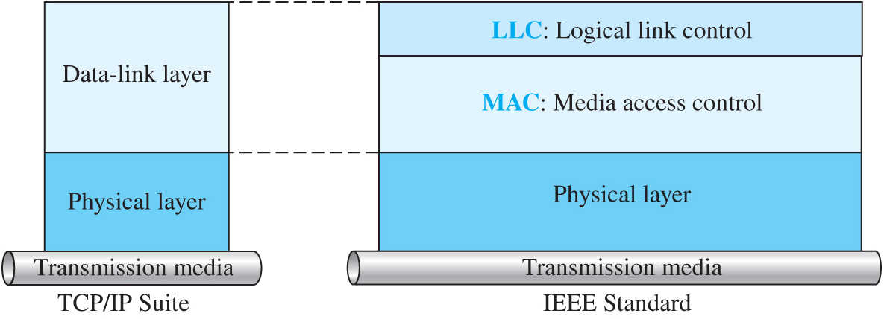
Figure 4.1 IEEE standard for LANs
Access the text alternative for slide images.

Slide 5
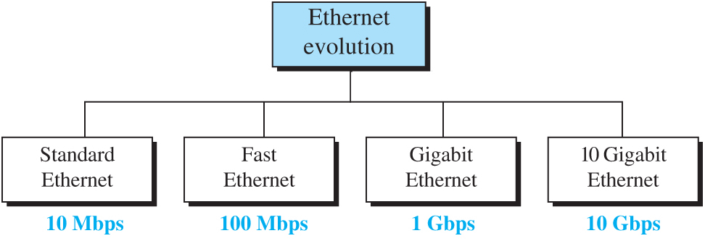
Figure 4.2 Ethernet evolution through four generations
Access the text alternative for slide images.

Slide 6
4.1.1 Standard Ethernet
We refer to the original Ethernet technology with the data rate of 10 Mbps as the Standard Ethernet. Although most implementations have moved to other technologies in the Ethernet evolution, there are some features of the Standard Ethernet that have not changed during the evolution. We discuss this standard version first.

Slide 7
Connectionless and Unreliable Service
Ethernet provide a connectionless service, which means that the frames are sent independent of each other.

Slide 8
Frame Format 1
The Ethernet frame contains seven fields, as shown in Figure 4.3.

Slide 9
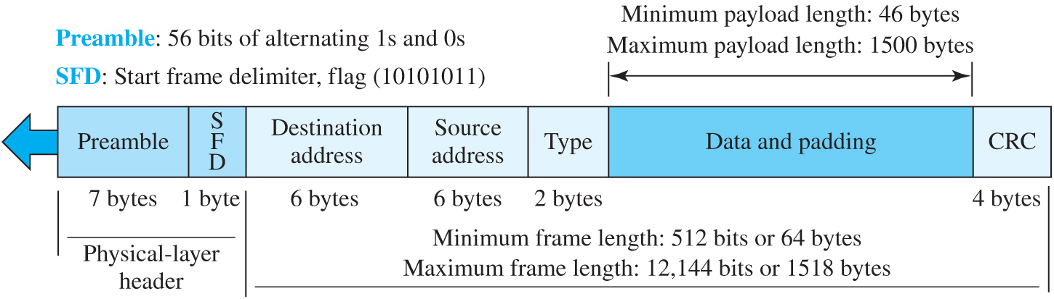
Figure 4.3 Ethernet frame
Access the text alternative for slide images.

Slide 10
Frame Length
Ethernet has imposed restriction on maximum and minimum length to provide correct operation of CSMA/CD. An Ethernet frame has minimum length of 64 bytes. The maximum length limit is 1518 bytes (without preamble and SFD). This means that maximum payload is 1500 bytes.

Slide 11
Addressing
Each station on an Ethernet network (such as a PC, workstation, or printer) has its own network interface card (NIC). The NIC fits inside the station and provides the station with a link-layer address. The Ethernet address is 6 bytes (48 bits), normally written in hexadecimal notation, with a colon between the bytes. For example, the following shows an Ethernet MAC address:
4A : 30 : 10 : 21 : 10 : 1A

Slide 12
Transmission of Address Bits
The way addresses are sent online is different from they way they are written in hexadecimal notation: Transmission is left to right, byte by byte; however, for each byte, the least significant bit that defines the address type is sent first.

Slide 13
Example 4.1
The example shows how how the address 47:20:1B:2E:08:EE is sent out online. The address is sent left to right, byte by byte; for each byte, it is sent right to left, bit by bit, as shown below:
Hexadecimal | 47 | 20 | 1B | 2E | 08 | EE
Binary | 01000111 | 00100000 | 00011011 | 00101110 | 00001000 | 11101110
Transmitted ← | 11100010 | 00000100 | 11011000 | 01110100 | 00010000 | 01110111

Slide 14
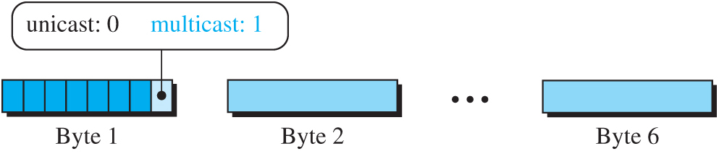
Figure 4.4 Unicast and multicast addresses
Access the text alternative for slide images.

Slide 15
Example 4.2
Define the type of the following destination addresses:
a. 4A : 30 : 10 : 21 : 10 : 1A
b. 47 : 20 : 1B : 2E : 08 : EE
c. FF : FF : FF : FF : FF : FF
Solution
a. This is a unicast address because A in binary is 1010 (even).
b. This is a multicast address because 7 in binary is 0111 (odd).
c. This is a broadcast address because all digits are Fs in hexadecimal.

Slide 16
Implementation 1
The standard Ethernet defines several implementation, but only four of them became popular.

Slide 17
Table 4.1 Summary of Standard Ethernet implementations
Implementation | Medium | Medium Length(m) | Encoding
10Base5 | Thick coax | 500 m | Manchester
10Base2 | Thin coax | 185 m | Manchester
10Base-T | 2 UTP | 100 m | Manchester
10Base-F | 2 Fiber | 2000 | Manchester

Slide 18
4.1.2 Fast Ethernet (100 Mbps)
In the 1990s, Ethernet made a big jump by increasing the transmission rate to 100 Mbps, and the new generation was called the Fast Ethernet. The designers of the Fast Ethernet needed to make it compatible with the Standard Ethernet. The MAC sublayer was left unchanged. But the features of the Standard Ethernet that depend on the transmission rate, had to be changed.

Slide 19
Access Method
We remember that the proper operation of the CSMA/CD depends on the transmission rate, the minimum size of the frame, and the maximum network length. If we want to keep the minimum size of the frame, the maximum length of the network should be changed. In other words, if the minimum frame size is still 512 bits, and it is transmitted 10 times faster, the collision needs to be detected 10 times sooner, which means the maximum length of the network should be 10 times shorter (the propagation speed does not change).

Slide 20
Auto-negotiation
A new feature added to Fast Ethernet is auto-negotiation. It allows two station to negotiate the mode or data rate of transmission.

Slide 21
Physical Layer 1
To be able to handle a 100 Mbps data rate, several changes need to be made at the physical layer.

Slide 22
Summary
Fast Ethernet implementation at the physical layer can be categorized as either two-wire or four-wire. The two-wire implementation can be either shielded twisted pair (STP), which is called 100Base-TX, or fiber-optic cable, which is called 100Base-FX. The four-wire implementation is designed only for unshielded twisted pair (UTP), which is called 100Base-T4. Table 4.2 is a summary of the Fast Ethernet implementations.

Slide 23
Table 4.2 Summary of Fast Ethernet implementations
Implementation | Medium | Medium Length | Wires | Encoding
100Base-TX | STP | 100 m | 2 | 4B/5B + MLT-3
100Base-FX | Fiber | 185 m | 2 | 4B/5B + NRZ-I
100Base-T4 | UTP | 100 m | 4 | Two 8B/6T

Slide 24
4.1.3 Gigabit Ethernet (1000 Mbps)
The need for an even higher data rate resulted in the design of the Gigabit Ethernet Protocol (1000 Mbps). The IEEE committee calls it the Standard 802.3z. The goals of the Gigabit Ethernet were to upgrade the data rate to 1 Gbps, but keep the address length, the frame format, and the maximum and minimum frame length the same.

Slide 25
MAC Sublayer
A main consideration in the evolution of Ethernet was to keep the MAC sublayer untouched. However, to achieve a data rate of 1 Gbps, this was no longer possible. Gigabit Ethernet has two distinctive approaches for medium access: half-duplex and full-duplex. Almost all implementations of Gigabit Ethernet follow the full-duplex approach, so we mostly ignore the half-duplex mode.

Slide 26
Full-Duplex Mode
In the full duplex mode, there is a central switch connected to all computers. There is no collision in this mode.

Slide 27
Half-Duplex Mode
In this mode, a switch can be replaced by a hub.

Slide 28
Physical Layer 2
The physical layer in Gigabit Ethernet is more complex that the other version. We have different implementations.

Slide 29
Table 4.3 Summary of Gigabit Ethernet implementations
Implementation | Medium | Medium Length(m) | Wires | Encoding
1000Base-SX | Fiber S-W | 550 m | 2 | 8B/10B + NRZ
1000Base-LX | Fiber L-W | 5000 m | 2 | 8B/10B + NRZ
1000Base-CX | STP | 25 m | 2 | 8B/10B + NRZ
1000Base-T4 | UTP | 100 m | 2 | 4D-PAM5

Slide 30
4.1.4 10-Gigabit Ethernet
In recent years, there has been another look into the Ethernet for use in metropolitan areas. The idea is to extend the technology, the data rate, and the coverage distance so that the Ethernet can be used as LAN and MAN (metropolitan area network). The IEEE committee created 10 Gigabit Ethernet and called it Standard 802.3ae.

Slide 31
Implementation 2
10 Gigabit Ethernet operates only in full-duplex mode, which means there is no need for contention; CSMA/CD is not used in 10 Gigabit Ethernet. Four implementations are the most common: 10GBase-SR, 10GBase-LR, 10GBase-EW, and 10GBase-X4. Table 4.4 shows a summary of the 10 Gigabit Ethernet implementations.

Slide 32
Table 4.4 Summary of 10-Gigabit Ethernet implementations
Implementation | Medium | Medium Length | Number of wires | Encoding
10GBase-SR | Fiber 850 nm | 300 m | 2 | 64B66B
10GBase-LR | Fiber 1310 nm | 10 km | 2 | 64B66B
10GBase-EW | Fiber 1350 nm | 40 km | 2 | SONET
10GBase-X4 | Fiber 1310 nm | 300 m to 10 km | 2 | 8B10B

Slide 33
4-2 WIFI, IEEE 802.11 PROJECT
IEEE has defined the specifications for a wireless LAN, called IEEE 802.11, which covers the physical and data-link layers. It is sometimes called wireless Ethernet. In some countries, including the United States, the public uses the term WiFi (short for wireless fidelity) as a synonym for wireless LAN. WiFi, however, is a wireless LAN that is certified by the WiFi Alliance.

Slide 34
4.2.1 Architecture
The standard defines two kinds of services: the basic service set (BSS) and the extended service set (ESS).

Slide 35
Basic Service Set (BSS)
IEEE defines the basic service set as the building block of a wireless LAN. It also defines an optional base station known as the access point (AP).

Slide 36
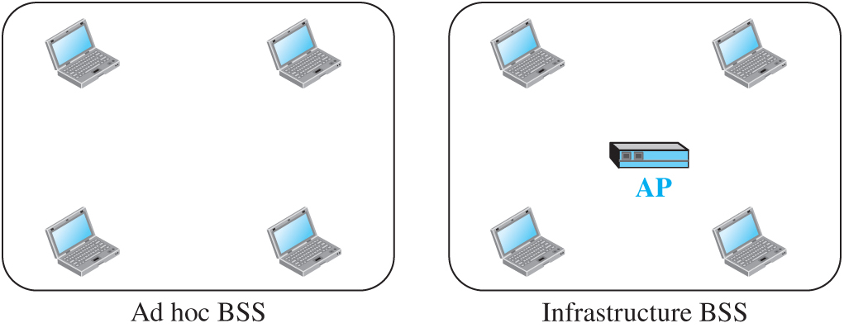
Figure 4.7 Basic service sets (BSSs)
Access the text alternative for slide images.

Slide 37
Extended Service Set (ESS)
An extended service set is made of two or more BSS with Aps that are connected together using a distribution system.

Slide 38
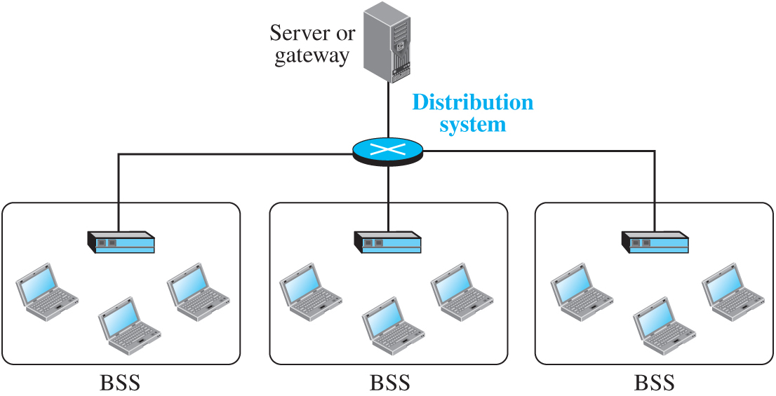
Figure 4.8 Extended service set (ESS)
Access the text alternative for slide images.

Slide 39
Station Type
IEEE defines three types of stations: no transition, BSS transition, and ESS transition.

Slide 40
4.2.2 MAC Sublayer
IEEE 802.11 defines two MAC sublayers: the distributed coordination function (DCF) and point coordination function (PCF). Figure 4.7 shows the relationship between the two MAC sublayers, the LLC sublayer, and the physical layer. We discuss the physical layer implementations later in the chapter and will now concentrate on the MAC sublayer.

Slide 41
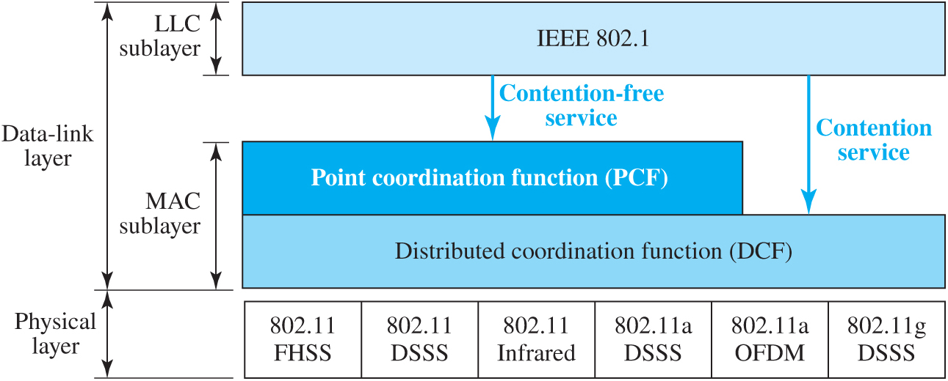
Figure 4.9 MAC layers in IEEE 802.11 standard
Access the text alternative for slide images.

Slide 42
Distribution Coordination Function (DCF)
One of the two protocol defined by IEEE at the MAC sublayer is called distribution coordination function (DCF), which uses CSMA/CD.

Slide 43
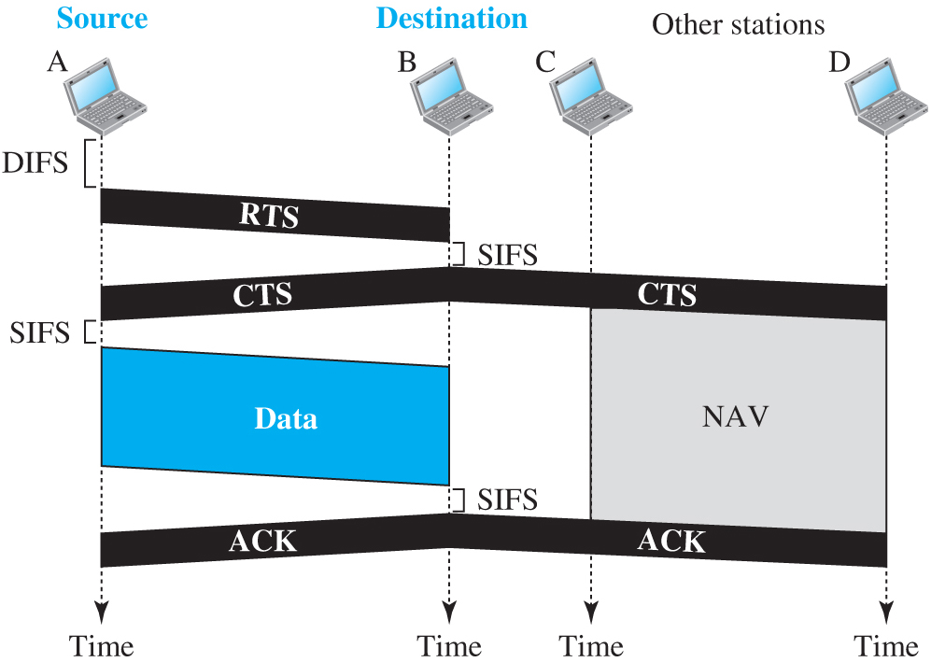
Figure 4.10 CSMA/CA and NAV
Access the text alternative for slide images.

Slide 44
Point Coordination Function (PCF)
This is an optional access that can be implemented in an infrastructure network. PCF has priority over DCF. However, to allow DCF frame to get access to the network repetition interval has been added to the network as shown in Figure 4.9.

Slide 45
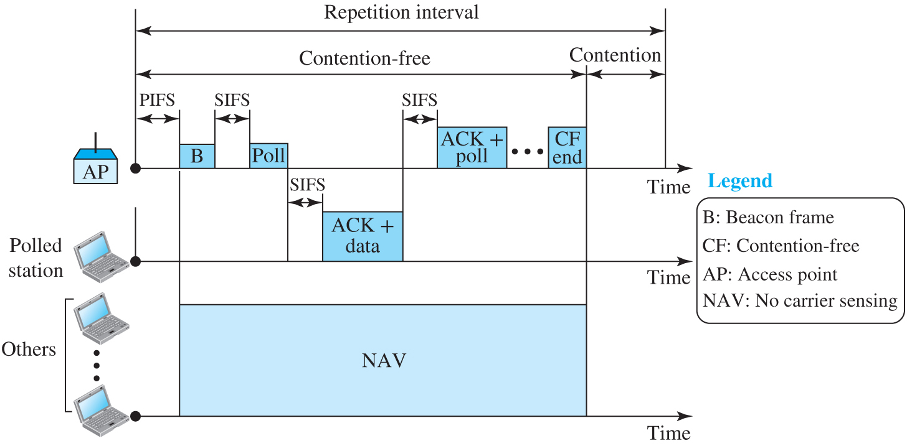
Figure 4.11 Example of repetition interval
Access the text alternative for slide images.

Slide 46
Fragmentation
The wireless environment is very noisy, so frames are often corrupted. A corrupted frame cannot be resubmitted. The protocol recommend fragmentation. The division of frame into smaller ones.

Slide 47
Frame Format 2
The MAC layer frame consists of nine fields as shown in Figure 4.10.

Slide 48
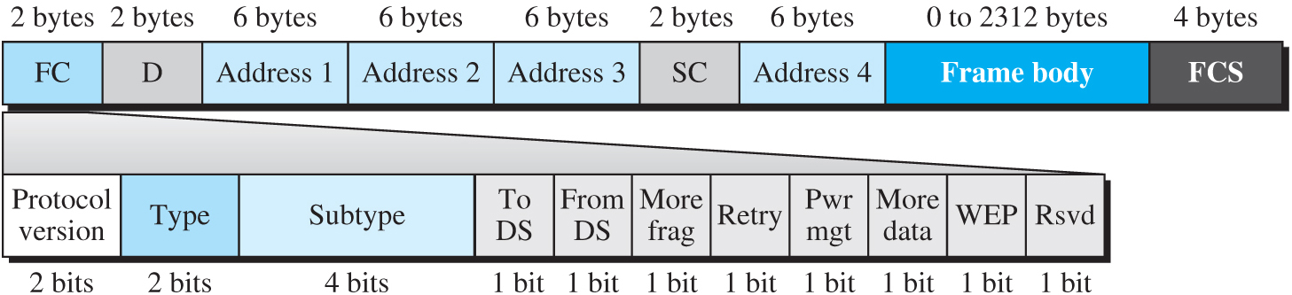
Figure 4.12 Frame format
Access the text alternative for slide images.

Slide 49
Table 4.5 Subfields in FC field
Field | Explanation
Version | Current version is 0
Type | Type of information: management (00), control (01), or data (10)
Subtype | Subtype of each type (see Table 4.6)
To DS | Defined later
From DS | Defined later
More flag | When set to 1, means more fragments
Retry | When set to 1, means retransmitted frame
Pwr mgt | When set to 1, means station is in power management mode
More data | When set to 1, means station has more data to send
WEP | Wired equivalent privacy (encryption implemented)
Rsvd | Reserved

Slide 50
Frame Type
A wireless LAN defined by IEEE 802.11 has three categories of frames: management frames, control frames, and data frames.

Slide 51
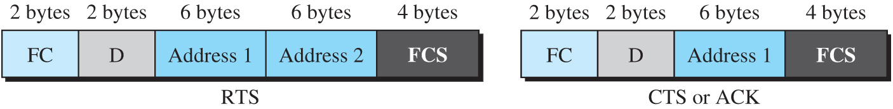
Figure 4.13 Control frames
Access the text alternative for slide images.

Slide 52
Table 4.6 Values of subfields in control frames
Subtype | Meaning
1011 | Request to send (RTS)
1100 | Clear to send (CTS)
1101 | Acknowledgment (ACK)

Slide 53
4.2.3 Addressing Mechanism
The IEEE 802.11 addressing mechanism specifies four cases, defined by the value of the two flags in the FC field, To DS and From DS. Each flag can be either 0 or 1, resulting in four different situations. The interpretation of the four addresses (address 1 to address 4) in the MAC frame depends on the value of these flags, as shown in Table 4.7.

Slide 54
Table 4.7 Addresses
To DS | From DS | Address 1 | Address 2 | Address 3 | Address 4
0 | 0 | Destination | Source | BSS ID | N/A
0 | 1 | Destination | Sending AP | Source | N/A
1 | 0 | Receiving AP | Source | Destination | N/A
1 | 1 | Receiving AP | Sending AP | Destination | Source

Slide 55
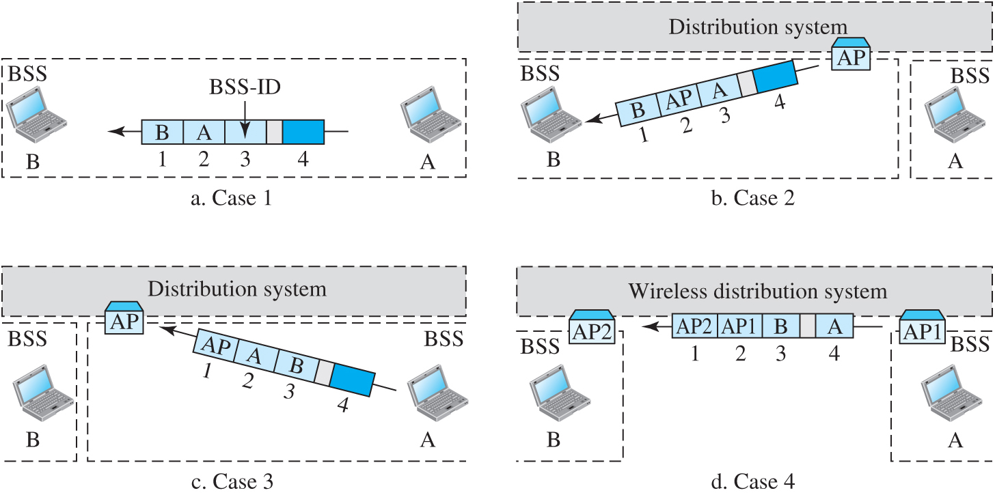
Figure 4.14 Addressing mechanisms
Access the text alternative for slide images.

Slide 56
Exposed Station Problem
A similar problem to the hidden station problem is exposed station problem. In this problem, refrains using a channel when the channel is available.

Slide 57
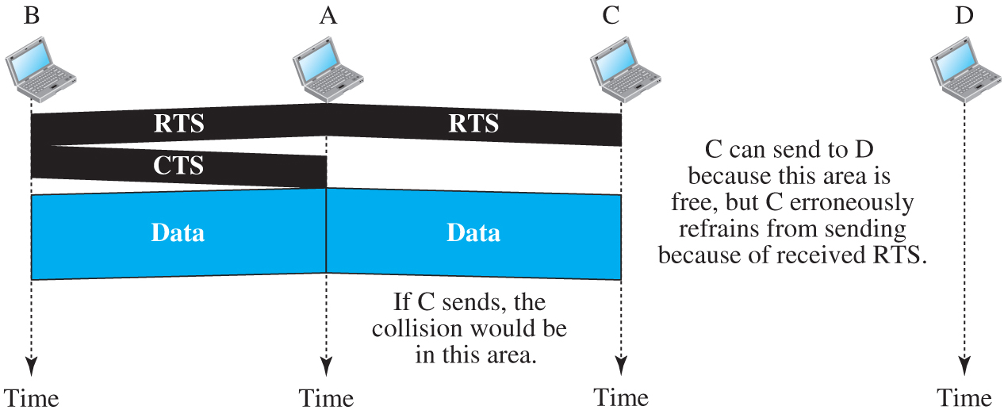
Figure 4.15 Exposed station problem
Access the text alternative for slide images.

Slide 58
4.2.4 Physical Layer
We discuss six specifications, as shown in Table 4.8. All implementations, except the infrared, operate in the industrial, scientific, and medical (ISM) band, which defines three unlicensed bands in the three ranges 902–928 MHz, 2.400–4.835 GHz, and 5.725–5.850 GHz.

Slide 59
Table 4.8 Specifications
IEEE | Technique | Band | Modulation | Rate (Mbps)
802.11 | FHSS | 2.400–4.835 GHz | FSK | 1 and 2
 | DSSS | 2.400–4.835 GHz | PSK | 1 and 2
 | None | Infrared | PPM | 1 and 2
802.11a | OFDM | 5.725–5.850 GHz | PSK or QAM | 6 to 54
802.11b | DSSS | 2.400–4.835 GHz | PSK | 5.5 and 11
802.11g | OFDM | 2.400–4.835 GHz | Different | 22 and 54
802.11n | OFDM | 5.725–5.850 GHz | Different | 600

Slide 60
4-3 BLUETOOTH
Bluetooth is a wireless LAN technology designed to connect devices of different functions when they are at a short distance from each other. A Bluetooth LAN is an ad- hoc network. The devices, sometimes called gadgets, find each other and make a network called a piconet.

Slide 61
4.3.1 Architecture
Bluetooth defines two types of networks: piconet and scatternet.

Slide 62
Piconet
A Bluetooth network is called a piconet (a small net). It can have up to 8 stations, one of which is called the primary; the other are called the secondaries.

Slide 63
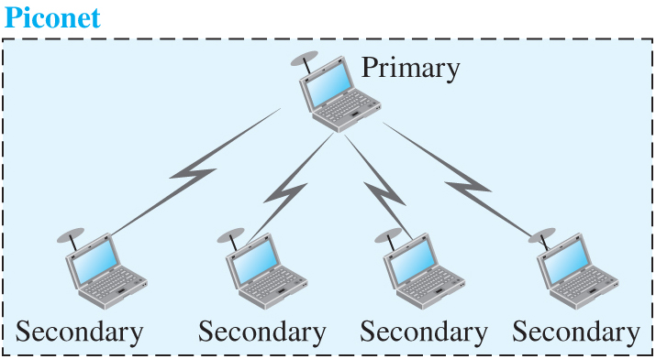
Figure 4.20 Piconet
Access the text alternative for slide images.

Slide 64
Scatternet
Piconets can be combined to create a scatternet. A secondary station in one piconet can be a primary in another one.

Slide 65
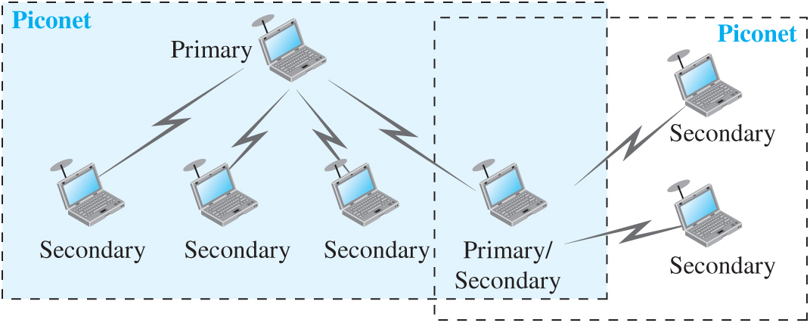
Figure 4.21 Scatternet
Access the text alternative for slide images.

Slide 66
Bluetooth Devices
A Bluetooth device has a built-in short-range radio transmitter. The current rate is 1 Mbps with a 2.4-GHz bandwidth.

Slide 67
Bluetooth Layers
Bluetooth uses several layers that do not exactly match those of the Internet model we have defined in this book. Figure 4.16 shows these layers.

Slide 68
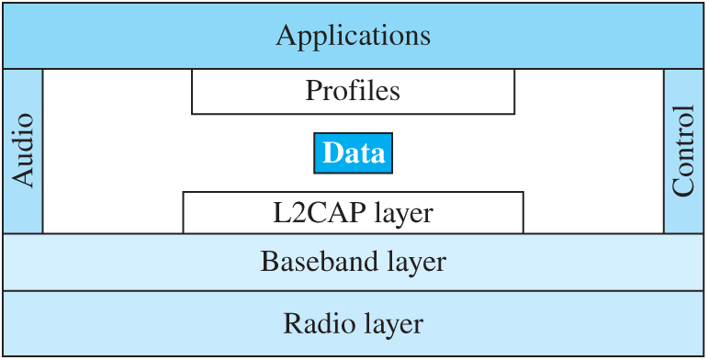
Figure 4.22 Bluetooth layers
Access the text alternative for slide images.

Slide 69
L2CAP
The Logical Link Control and Adaption Protocol is roughly equivalent to the LLC sublayer in LANs.

Slide 70
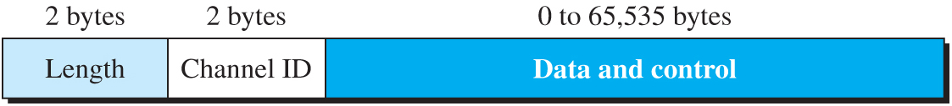
Figure 4.23 L2CAP data packet format
Access the text alternative for slide images.

Slide 71
Baseband Layer
The Baseband layer is roughly equivalent to MAC sublayer in LANs.

Slide 72
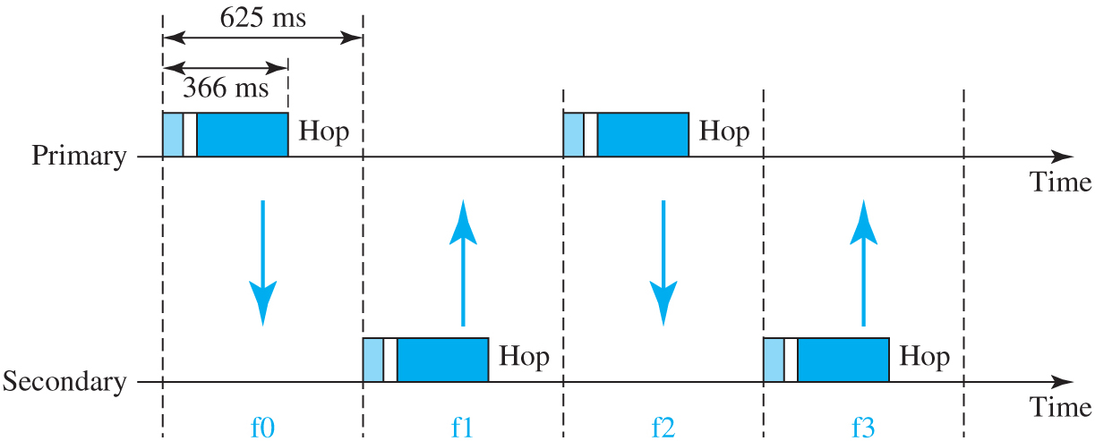
Figure 4.24 Single-secondary communication
Access the text alternative for slide images.

Slide 73
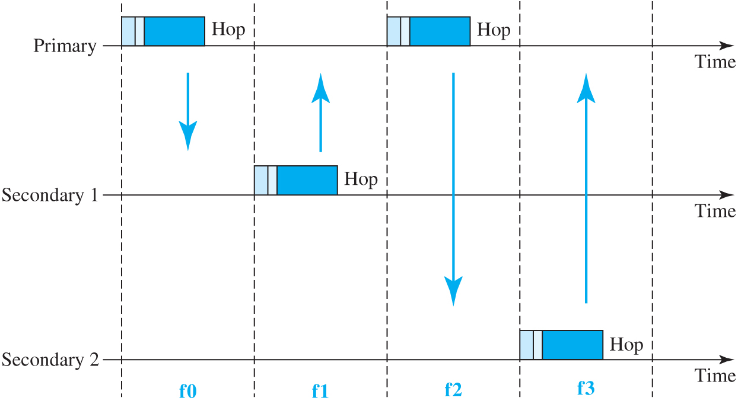
Figure 4.25 Multiple-secondary communication
Access the text alternative for slide images.

Slide 74
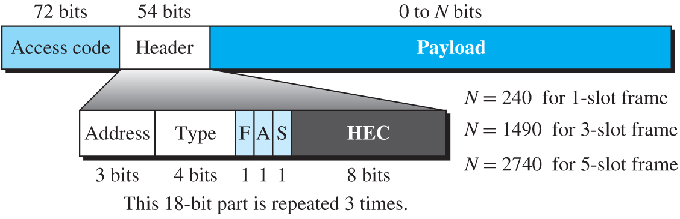
Figure 4.26 Frame format types
Access the text alternative for slide images.

Slide 75
Radio Layer
The radio layer is roughly equivalent to the physical layer of the Internet model. Bluetooth devices are low-power and have a range of 10 m.

Slide 76
End of Main Content
© 2022 McGraw Hill, LLC. All rights reserved. Authorized only for instructor use in the classroom.
No reproduction or further distribution permitted without the prior written consent of McGraw Hill, LLC.

Slide 77
Accessibility Content: Text Alternatives for Images

Slide 78
Figure 4.1 IEEE standard for LANs - Text Alternative
Return to parent-slide containing images.
The O S I or T C P/I P suite represents the data-link layer and physical layer, the I E E standard represents logical link control (L L C), Ethernet media access control (M A C), Token ring M A C and token bus M A C, Ethernet physical layer, token ring physical layer, and token bus physical layer.
Return to parent-slide containing images.

Slide 79
Figure 4.2 Ethernet evolution through four generations - Text Alternative
Return to parent-slide containing images.
The Ethernet evolution represents standard Ethernet with 10 M b p s, fast ether with 100 M b p s, Gigabit Ethernet with 1 G b p s, and 10 Gigabit Ethernet with 10 G b p s.
Return to parent-slide containing images.

Slide 80
Figure 4.3 Ethernet frame - Text Alternative
Return to parent-slide containing images.
A bar represents 7 bytes preamble 56 bits of alternating 1s and 0s and 1-byte start frame delimiter, flag (1 0 1 0 1 0 1 1). The first two layers represents the physical layer, 6 bytes destination address, 6 bytes source address, 2 bytes type, data, and padding represent minimum payload length of 46 bytes and maximum payload length of 1500 bytes, and 4 bytes C R C. The destination address to C R C represents minimum frame length of 512 bytes or 64 bytes, and maximum frame length of 12,144 bits or 1518 bytes.
Return to parent-slide containing images.

Slide 81
Figure 4.4 Unicast and multicast addresses - Text Alternative
Return to parent-slide containing images.
Six bytes are shown, each with eight parts. The eighth part represents unicast 0 and multicast 1.
Return to parent-slide containing images.

Slide 82
Figure 4.7 Basic service sets (BSSs) - Text Alternative
Return to parent-slide containing images.
The infrastructure B S S represents four laptops with a signal receiver and an A P with a signal receiver. Ad hoc B S S represents four laptops with a signal receiver.
Return to parent-slide containing images.

Slide 83
Figure 4.8 Extended service set (ESS) - Text Alternative
Return to parent-slide containing images.
The server or gateway that connects to a router represents the distribution system. The router is connected to three B S S. The B S S includes An A P with the signal receiver and three laptops with signal receivers.
Return to parent-slide containing images.

Slide 84
Figure 4.9 MAC layers in IEEE 802.11 standard - Text Alternative
Return to parent-slide containing images.
The data link layer includes L L C sublayer includes I E E E 802.1 and M A C sublayer includes point coordination function (P C F) and distributed coordination function (D C F), where the I E E E 802.1 L L C connects to P C F representing contention-free service and to the DC F representing contention service. The physical layer includes 802.11 F H S S, 802.11 D S S S, 802.11 infrared, 802.11 a D S S S, 802.11a O F D M, and 802.11 g D S S S.
Return to parent-slide containing images.

Slide 85
Figure 4.10 CSMA/CA and NAV - Text Alternative
Return to parent-slide containing images.
An illustration shows the communication between a source and destination. The source exhibits a DCF Interframe Spacing (DIFS) and sends a ready to send (RTS) request to the destination. The destination has several devices. It exhibit a short interframe spacing (SIFS) and then sends the clear to send (CTS) status to source. Nov a network allocation vector (NAV) is created at the destination side. The source sends the data. The destination exhibits SIFS and sends an acknowledgement to source and also to other destination devices.
Return to parent-slide containing images.

Slide 86
Figure 4.11 Example of repetition interval - Text Alternative
Return to parent-slide containing images.
An A P represents P I F S, a beacon frame, S I F S, Poll, S I F S, A C K plus poll, and contention-free end and contention, where from P I F S to contention-free end represents contention-free, and from P I F S to contention represents repetition interval. The polled station laptop includes S I F S and A C K plus data. The others include no carrier sensing.
Return to parent-slide containing images.

Slide 87
Figure 4.12 Frame format - Text Alternative
Return to parent-slide containing images.
A bar represents 2 bytes F C, 2 bytes D, 6 bytes Address 1, 6 bytes Address 2, 6 bytes Address 3, 2 bytes S C, 6 bytes Address 4, 0 to 2312 bytes frame body, and 4 bytes F C S. The 2 bytes FC represents a bar that includes 2 bits protocol version, 2 bits type, 4 bits subtype, 1 bit To D S, 1 bit from D S, 1 bit more frag, 1 bit retry, 1 bit pwr management, 1 bit more data, 1 bit W E P and 1 bit R s v d.
Return to parent-slide containing images.

Slide 88
Figure 4.13 Control frames - Text Alternative
Return to parent-slide containing images.
The R T S includes 2 bytes F C, 2 bytes D, 6 bytes address 1, 6 bytes address 2, and 4 bytes F C S. The C T S or A C K includes 2 bytes F C, 2 bytes D, 6 bytes address 1 and 4 bytes F C S.
Return to parent-slide containing images.

Slide 89
Figure 4.14 Addressing mechanisms - Text Alternative
Return to parent-slide containing images.
The addressing mechanisms are shown in four cases. Case 1 represents laptop A transmitting to B through a frame that includes B labeled as 1, A labeled as 2, B S S I D labeled as 3, and blank 4. Case 2 represents the distribution system includes B S S labeled as A and B. A P from B S S transmits a frame to B S S labeled as B that includes B labeled as 1, A P labeled as 2, A labeled as 3, and blank 4. Case 3 represents a distribution system with B S S labeled A and B. B S S A transmits to A P in B S S B through a frame that includes A P labeled as 1, A labeled as 2, B labeled as 3, and blank 4. Case 4 represents wireless distribution system includes B S S labeled A and B. B S S A transmits a frame from AP1 to AP2 of B S S B. The frame includes A P 2 labeled as 1, A P 1 labeled as 2, B labeled as 3 and A labeled as 4.
Return to parent-slide containing images.

Slide 90
Figure 4.15 Exposed station problem - Text Alternative
Return to parent-slide containing images.
Laptop labeled as B transmits R T S, C T S, and data to laptop labeled as A. A transmits R T S and data if C sends, the collision would be in this area to laptop labeled as C. The C can send to laptop D because this area is free, but C erroneously refrains from sending because of received R T S.
Return to parent-slide containing images.

Slide 91
Figure 4.20 Piconet - Text Alternative
Return to parent-slide containing images.
The primary laptop with signal receivers transmits to four secondary laptops with signal receivers.
Return to parent-slide containing images.

Slide 92
Figure 4.21 Scatternet - Text Alternative
Return to parent-slide containing images.
A primary laptop transmits to three secondary laptops and one primary or secondary laptop, where a piconet with two secondary laptops transmits to the primary or secondary laptop.
Return to parent-slide containing images.

Slide 93
Figure 4.22 Bluetooth layers - Text Alternative
Return to parent-slide containing images.
The Bluetooth layers include the applications layer, audio, profiles, data, L 2 C A P layer and control, baseband layer, and radio layer.
Return to parent-slide containing images.

Slide 94
Figure 4.23 L2CAP data packet format - Text Alternative
Return to parent-slide containing images.
A bar represents 2 bytes length, 2 bytes channel I D, and 0 to 65,535 bytes data and control.
Return to parent-slide containing images.

Slide 95
Figure 4.24 Single-secondary communication - Text Alternative
Return to parent-slide containing images.
An illustration shows primary and secondary communication. Primary includes bands of 366 ms and a Hop. Both measures 625 ms. The frame is found in f0 and f2 regions. Secondary includes 366 ms, Hop and both measures 625 ms in f1 and f3 regions.
Return to parent-slide containing images.

Slide 96
Figure 4.25 Multiple-secondary communication - Text Alternative
Return to parent-slide containing images.
Primary includes bands and Hop in f0 and f2. Secondary 1 includes bands and Hop in f1. Secondary 2 includes bands and Hop in f3.
Return to parent-slide containing images.

Slide 97
Figure 4.26 Frame format types - Text Alternative
Return to parent-slide containing images.
A bar represents 72 bits access code, 54 bits header, and 0 to N bits payload. The header bar represents 3 bits address, 4 bits type, 1 F, 1 A, 1 S, and 8 bits H E C, where this 18-bit part is repeated 3 times, N is 240 for 1-slot frame, N is 1490 for 3-slot frame, and N is 2740 for 5-slot frame.
Return to parent-slide containing images.

